Slide 1




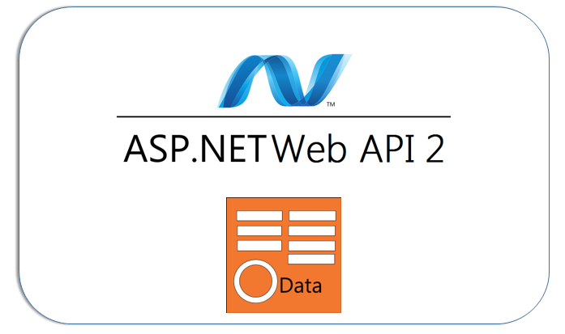

LINQ & OData
Basics & some advanced topics
LINQ
OData
SoftUni Team
Technical Trainers
Software University
http://softuni.bg

Slide 2

Table of Contents
Before LINQ – IEnumerable interface and collections
LINQ to objects
IQueryable interface
Expression trees
OData

Slide 3
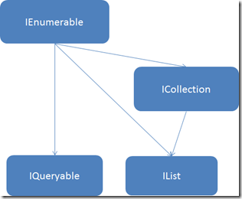
IEnumerable interface and collections
Before LINQ was created

Slide 4
IEnumerable and IEnumerable<T>
Supports 3 major actions
MoveNext
Reset
Current
Used with foreach()
Iterates through all of the elements

Slide 5
yield return and yield break
Used inside an iterator block
Used for deferred (lazy) evaluation
yield return provides the next value to the enumerator
yield break signals the end of iteration

Slide 6
IEnumerable and yield – example 1 / 2
public IEnumerable<ValidationError> GetErrors(Attribute attribute)
{
if (attribute.CriticalError != null)
{
yield return attribute.CriticalError;
yield break;
}
foreach (var error in attribute.Errors)
{
error.PropertyName = attribute.PropertyName;
yield return error;
}
}

Slide 7
IEnumerable and yield – example 2 / 2
public IEnumerable<string> GetMonths()
{
yield return "January";
yield return "February";
yield return "March";
…
}

Slide 8
ICollection and ICollection<T>
Extends IEnumerable
Defines a property Count
Allows thread safety via IsSynchronized and SyncRoot
Base type for sequential data types like Queue and Stack

Slide 9
IList and IList<T>
Extends ICollection
Allows access to individual elements by index
Defines methods like Add, Insert, Remove, RemoveAt, Clear
Can be read-only, fixed-size, and variable-size

Slide 10
Example – IList<T>
Var colors = new List<string>();
colors.Add("Red");
colors.Add("Green");
colors.Add("Blue");
var colors2 = new List<string>
{
"Red",
"Green",
"Blue", //Comma is allowed after the last element
}
Var greenColor = colors[1];

Slide 11
IDictionary and IDictionary<T>
Extends ICollection
Collection of key/value pairs
Each pair must have a unique key
Defines methods like Add, Remove, Clear, Contains
Defines properties like Keys and Values
Can be read-only, fixed-size, and variable-size

Slide 12

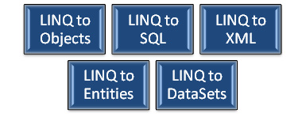
LINQ to objects
Enter LINQ

Slide 13
What is LINQ?
Language INtegrated Query
Introduced with System.Linq namespace
Utilizes the extension methods
Takes advantage of lambda-expressions
Can be used against any IEnumerable collection
Has two forms – declarative (query) syntax and method syntax
Both forms return an IEnumerable or some descendant
(IOrderedEnumerable, IGrouping, IQueryable)

Slide 14
Example – basic LINQ (declarative syntax)
List<Movie> movies;
…
var moviesQuery = from movie in movies
where movie.Title.StartsWith("S")
orderby movie.Year descending
select movie;
More natural syntax (SQL like)
select is always last

Slide 15
Example – basic LINQ (method syntax)
List<Movie> movies;
…
var moviesQuery = movies
.Where(m => m.Title.StartsWith("S"))
.OrderByDescending(m => m.Year);
More functional (fluent) syntax
.Where(), OrderByDescending() are extension methods

Slide 16
Example 2 – advanced LINQ
List<Movie> movies;
…
var actorsQuery = movies
.SelectMany(m => m.Actors)
.Where(a => a.StartsWith("B"))
.Distinct()
.OrderBy(a => a);
Selects actors from the Actors List<string>
Filters them by letter "B"
Selects unique names
Orders by name

Slide 17
Different parts of the query
Projection operator
Filter (restriction) operator
var actorsQuery = movies
.SelectMany(m => m.Actors)
.Where(a => a.StartsWith("B"))
.Distinct()
.OrderBy(a => a);
Set operator
Ordering operator

Slide 18
Example 3 – advanced LINQ
List<Movie> movies;
…
var moviesQuery = movies
.Where(m => m.Score >= 8.0)
.OrderBy(m => m.Year);
.ThenBy(m => m.Title)
.Select((m, i) => new
{
FullTitle = string.Format("{0}. {1} ({2}), {3}",
i + 1,
m.Title,
m.Year,
m.Director),
Actors = m.Actors.Count()
});
In this case i is current index

Slide 19
Deferred query evaluation
The query is composed in memory and is not evaluated until:
foreach() (lazy evaluation)
.ToList(), .ToArray() (eager evaluation)
Any method that returns a singleton result – Average(), Count(), First(), SingleOrDefaulth(), Max()
When used on an IEnumerable ALL elements in the collection are iterated before they are filtered, sorted, etc.

Slide 20
LINQ operator types (1/2)
Restriction (Where)
Projection (Select, SelectMany)
Partitioning (Take, Skip, TakeWhile, SkipWhile)
Ordering (OrderBy, OrderByDescending, ThenBy, Reverse)
Grouping (GroupBy)
Aggregate(Count, Sum, Min, Max, Average, Aggregate)

Slide 21
LINQ operator types (2/2)
Set (Distinct, Union, Intersect, Except)
Element (First, FirstOrDefault, Single, SingleOrDefault)
Conversion (ToArray, ToList, ToDictionary, OfType)
Generation (Range, Repeat)
Quantifiers (Any, All)
Misc (Concat, EqualAll)

Slide 22
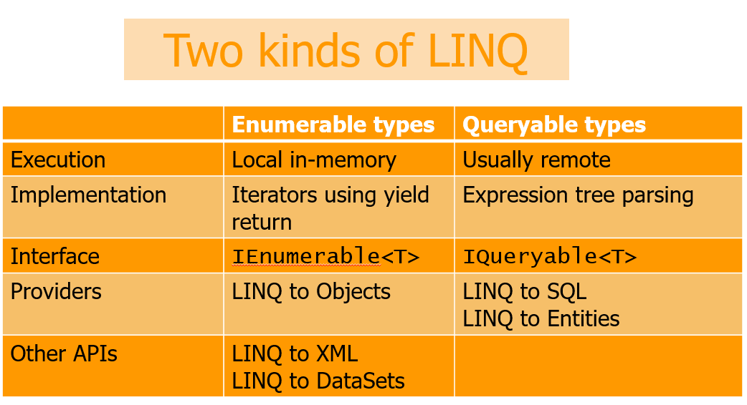
IQueryable interface

Slide 23
What is IQueryable?
Extends IEnumerable (basically)
Can operate on expression trees
Utilizes a query provider
Saves a lot of resources (when implemented properly)
Much more difficult and complex to implement

Slide 24
The difference – example 1/2
This will load All the products into memory before filtering
This will execute “SELECT * FROM Products WHERE Cost >= 25”
IEnumerable<Product> products = context.GetEnumerableProducts();
var productsOver25 = products.Where(p.Cost >= 25.0);
IQueryable<Product> products = context.GetQueryableProducts();
var productsOver25 = products.Where(p.Cost >= 25.0);

Slide 25
The difference – example 2/2
This will load at least 4 * pageSize products
This will execute “SELECT * FROM Products LIMIT 60, 20”
Var pageSize = 20;
IEnumerable<Product> products = context.GetEnumerableProducts();
var productsOnPage4 = products.Skip(pageSize * 3).Take(pageSize);
Var pageSize = 20;
IQueryable<Product> products = context.GetQueryableProducts();
var productsOnPage4 = products.Skip(pageSize * 3).Take(pageSize);

Slide 26
How does it work?
Executing functions vs. expression trees
A function is defined as Func<TResult> (Func<T, TResult>, etc)
This is pretty much a pointer to the method (delegate)
A tree data structure is defined as Expression<Func<TResult>>
The tree structure describes what a lambda expression does

Slide 27
How does it work - example
Regular (delegate) function
Func<int, string> anonPage = (i) => "Page {i}";
string anonPage(int i) {return "Page {i}";}
Expression
Expression<Func<int, string>> anonPage = (i) => "Page {i}";
Cannot use var to make implicit-typed variable
var anonPage = () => 10; //Nope, compiler error

Slide 28
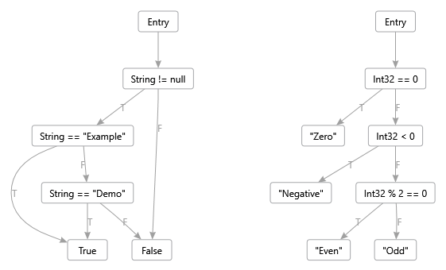
Expressions – what’s inside? 1/2
Expression<Func<int, string>> expr = i => i == 0 ? "Zero" :
i < 0 ? "Negative" : i % 2 == 0 ? "E: "Odd";
IEnumerable<string> result = integers.Select(expr);

Slide 29
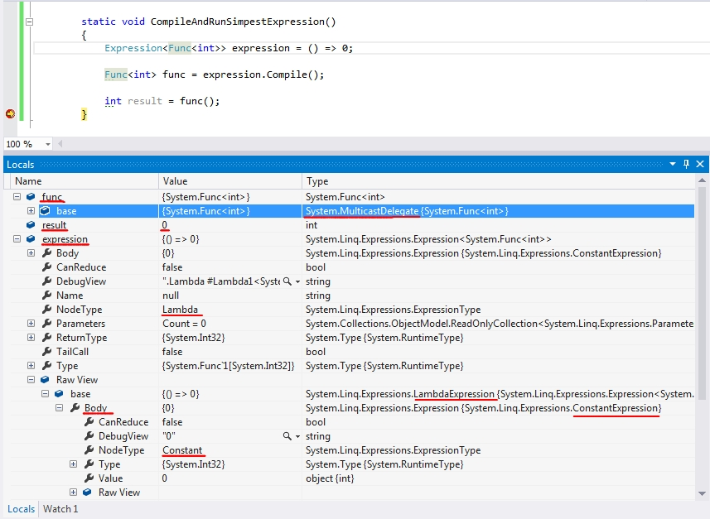
Expressions – what’s inside? 2/2

Slide 30
Expressions as data
Expression (trees) are the data
Can be constructed with lambda expressions or using API syntax
Can be compiled to a delegate Func<T>
It’s like a language within the language
Trees can be observed/translated/modified using ExpressionVisitor
Translating a Func<T> to an Expression<Func<T>> would mean to decompile the method (not very useful)

Slide 31
Example – compiling an Expression
Expression<Func<int, string>> expression = (i) => "Page {i}";
Func<int, string> func = expression.Compile();
var result = func(5);
//result will contain "Page 5“
…
var parameterI = Expression.Parameter(typeof(int), "i");
var constantOne = Expression.Constant(1);
var sum = Expression.Add(constantOne, parameterI);
Expression<Func<int, int>> expression =
Expression.Lambda<Func<int, int>>(sum, new[]{ parameterI });
Func<int, int> func = expression.Compile();
var result = func(5);
//result will contain 6

Slide 32
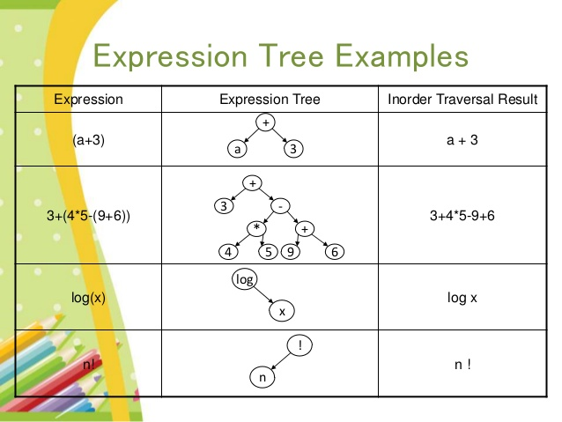
Sample expression trees – 1/2

Slide 33
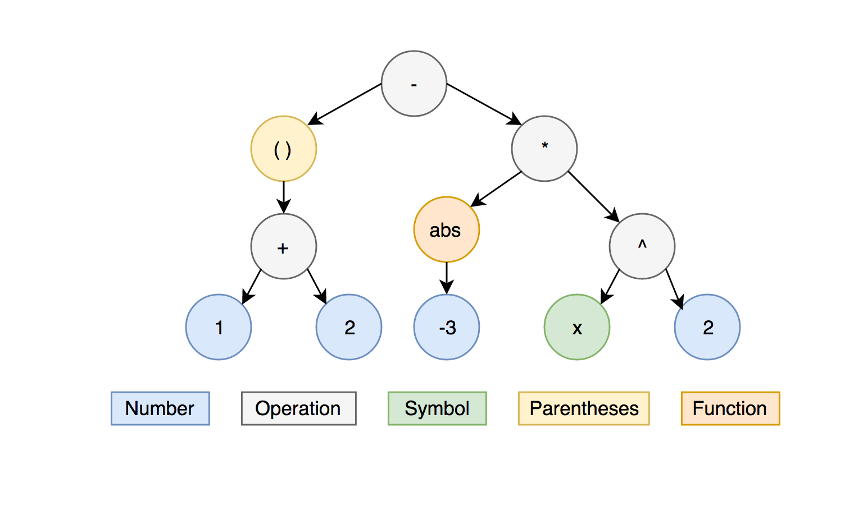
Sample expression trees – 2/2
The expression tree for (1 + 2) - abs(-3) * x²

Slide 34
Some node types – 1/2
Node type | Description
Add | Arithmetic addition w/o overflow checking
AddChecked | Arithmetic addition with overflow checking
And | Bitwise or logical AND operation
ArrayIndex | Indexes an item in 1-dimensional array
Call | Method call
Conditional | Conditional operator – a ? b : c
Constant | Constant value
Equal | Equality comparison
GreaterThanOrEqual | x >= 5 (numerical comparison)
MemberAccess | Read from field or property
New | Calls a constructor or creates an object

Slide 35
Some node types – 2/2
Node type | Description
NewArrayInit | Create 1-dimensional array from a list
Parameter | Reference a parameter in the context
Switch | The “switch” operator
Throw | An operation that throws an exception
Try | A try/catch expression
TypeAs | The “as” C# operator
TypeIs | The “is” C# operator

Slide 36
Some expression types
Expression type | Node types
BinaryExpression | Add, AddChecked, And, Equal, LeftShift, …
ConditionalExpression | Conditional
ConstantExpression | Constant
Expression<T> | Lambda
ListInitExpression | ListInit
MemberExpression | MemberAccess
MethodCallExpression | Call
NewExpression | New
ParameterExpression | Parameter
SwitchExpression | Switch
UnaryExpression | ArrayLength, Increment, IsTrue, Not, …

Slide 37
Visiting the expression tree
The Visit method is long but simple
There is a specific method for visiting each type of node, based on the available properties
E.g. BinaryExpression has Left and Right
ConstantExpression and ParameterExpression are leaf expressions
MethodCallExpression and InvocationExpression need to visit their parameters
LambdaExpression needs to visit its Body

Slide 38
Why do we Visit the tree?
To translate the tree into another form
LINQ to SQL converts in-memory expression tree to a SQL query
To modify the properties of a node
Once constructed nodes are immutable and we need to create a new node to replace the old one
To add/remove nodes or combine branches

Slide 39
Extending LINQ
Extension methods for IEnumerable operate on Func<T>
Extension methods for IQueryable operate on Expression<Func<T>>
If you pass IEnumerable to an IQueryable method it will work because IQueryable inherits from IEnumerable, but:
It will use IEnumerable extension method
All entities will be loaded into memory

Slide 40
What is OData?
REST-based protocol for CRUD-style operations
The data access API in a web-based world
Built on top of AtomPub, which is built on top of Atom
Basically all results and requests are done in XML or JSON
Exposed as service URLs

Slide 41
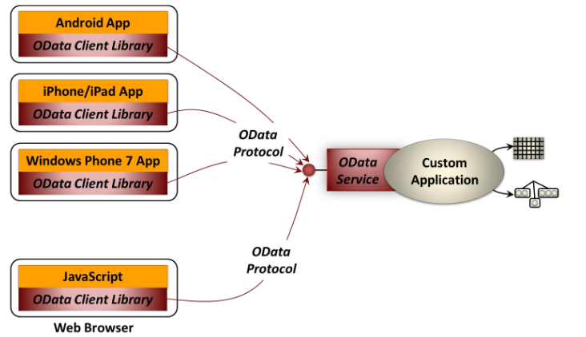
Common usage of OData

Slide 42
Entity data model – 1/3
Base component – Entity
Entities are connected through Associations
Associations can be one-to-one or many-to-one
Associations can be unidirectional or bidirectional
All entities are organized into hierarchy
Entity set
Entity container
EDM describes only the logical structure
How data is stored physically is irrelevant

Slide 43
Entity data model – 2/3
Entities contains Properties
Properties can be of any of 14 commonly used types like
String
Int32
Boolean
Guid
Double

Slide 44
Entity data model – 3/3
Special properties are called Navigation Properties
They represent the associations
Entities might be mapped to:
Relational database tables
Server-side-objects (e.g. Java components)
Physical files on a server (e.g. attachments to a message)

Slide 45
CRUD operations using REST
GET – Read
POST – Create
PUT – Update, replaces ALL properties
MERGE – Update, replaces only specified properties
DELETE - Delete

Slide 46
Sample OData result
https://services.odata.org/v3/OData/OData.svc
<service xml:base="https://services.odata.org/V3/OData/OData.svc/">
<workspace>
<atom:title>Default</atom:title>
<collectionhref="Products">
<atom:title>Products</atom:title>
</collection>
<collectionhref="ProductDetails">
<atom:title>ProductDetails</atom:title>
</collection>
…
</workspace>
</service>

Slide 47
Sample OData result - metadata
https://services.odata.org/v3/OData/OData.svc/$metadata
<edmx:Edmx Version="1.0">
<edmx:DataServices m:DataServiceVersion="3.0" m:MaxDataServiceVersion="3.0">
<Schema Namespace="ODataDemo">
<EntityType Name="Product">
<Key>
<PropertyRef Name="ID"/>
</Key>
<Property Name="ID" Type="Edm.Int32“ Nullable="false"/>
<Property Name="Name" Type="Edm.String" m:FC_TargetPath="SyndicationTitle" m:FC_ContentKind="text" m:FC_KeepInContent="false"/>
<Property Name="Description" Type="Edm.String" m:FC_TargetPath="SyndicationSummary" m:FC_ContentKind="text“ m:FC_KeepInContent="false"/>
<NavigationProperty Name="ProductDetail" Relationship="ODataDemo.Product_ProductDetail_ProductDetail_Product" ToRole="ProductDetail_Product" FromRole="Product_ProductDetail"/>
</EntityType>
<EntityType Name="ProductDetail" BaseType="ODataDemo.Product">
<Key>
<PropertyRef Name="ProductID"/>
</Key>
<Property Name="ProductID" Type="Edm.Int32" Nullable="false"/>
<Property Name="Details" Type="Edm.String"/>
<NavigationProperty Name="Product" Relationship="ODataDemo.Product_ProductDetail_ProductDetail_Product" ToRole="Product_ProductDetail" FromRole="ProductDetail_Product"/>
</EntityType>
</Schema>
</edmx:DataServices>
</edmx:Edmx>

Slide 48
OData client libraries
WCF Data Services (.NET 4.0+)
XMLHttpRequest in browser that support it
jQuery
LINQPad
Anything that can talk with HTTP

Slide 49
Be careful
WCF Data Services do not support some of the LINQ methods
All, Any
Select
GroupBy
Min, Max
ElementAt
Unit tests with mocked contexts will work, but…
… code tested by passing tests will fail at runtime

Slide 50
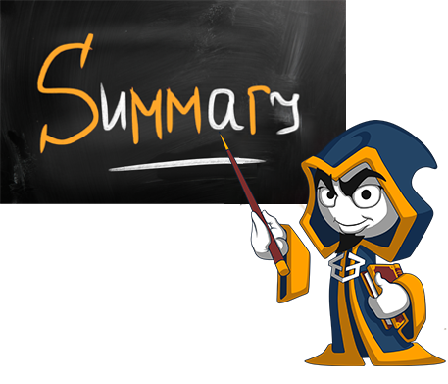
Summary
JSON and XML are cross platform data formats
DataContractJsonSerializer is the default JSON Parser in C#
JSON.NET is a fast framework for working with JSON data

Slide 51







External Format Processing
https://softuni.bg/courses/databases-basics-ms-sql-server

Slide 52






SoftUni Diamond Partners

Slide 53






SoftUni Diamond Partners

Slide 54
License
This course (slides, examples, demos, videos, homework, etc.) is licensed under the "Creative Commons Attribution-NonCommercial-ShareAlike 4.0 International" license
Attribution: this work may contain portions from
"Databases" course by Telerik Academy under CC-BY-NC-SA license

Slide 55





Trainings @ Software University (SoftUni)
Software University – High-Quality Education, Profession and Job for Software Developers
softuni.bg
Software University Foundation
http://softuni.foundation/
Software University @ Facebook
facebook.com/SoftwareUniversity
Software University Forums
forum.softuni.bg

